Slide 1
FY26 Year-end
Thank you for joining! Please note:
We ask that participants keep microphones muted.
This session will be recorded and you can request a copy of the recording by emailing accounting@brown.edu.
Questions can be submitted via chat during the Zoom session or emailed anytime to accounting@brown.edu

Slide 2
Year-end Process
Fiscal Year 2026
Nichole Curley, Controller’s Office

Slide 3
Agenda
Importance of Year-end close
Information and key dates
Procurement
Accounts Payable
Payroll
Cashier
General Accounting
Reminders & Updates

Slide 4

Year-end close for Brown
No significant change in process from prior year
Don’t wait until July!

Slide 5
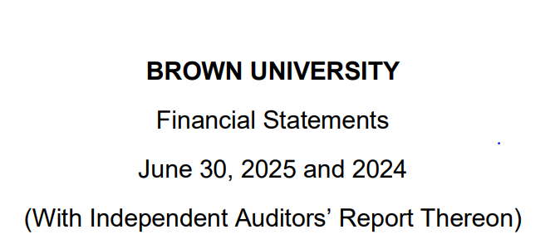

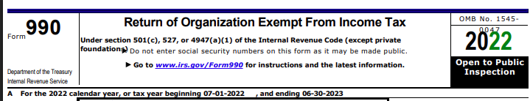
Importance of a Close
To prepare complete and accurate financial statements for the University for the period ending June 30, 2026 to distribute to our stakeholders (i.e. trustees, government agencies, bondholders).
Notes:
Budget – Taxes – FS

Slide 6
Procurement
2026 Direction for Purchases
Spend Category Reminders
Creating New Orders
Blanket Orders
Receipting Goods & Services
Closing Purchase Orders
Tips to Avoid Delays
Courtney Wuethrich, Systems Operations Manager

Slide 7
2026 Direction for Purchases
Follow Procurement policies SPC Policies
Be sure to have an approved PO Requisition before purchasing goods or services; it is a violation of Financial Policy to request a Purchase Order after the purchase has been made
Ensure the needed supplier is set up in Workday
Ensure that needed documentation is attached; each item must be uploaded individually. Select External if it is to be sent to the Supplier.

Slide 8
2026 Direction for Purchases (continued)
Sole Source Documentation: Updates to the Competitive Bidding Policy and Sole Source Justification coming soon. SPC emphasizes that price alone is not valid sole source justification. Departments must clearly explain why the supplier is the only viable option (e.g. unique capabilities or exclusive rights).

Slide 9
Spend Category Reminders
Using the correct spend category on a requisition is critical:
To obtain needed financial operational approvals
To ensure appropriate financial reporting (including in our 990)
To support the University’s ability to perform spend analysis
The Spend Category document is “living” document – Do not save it to your desktop!!!
Please see the spend category listing on the Controller’s web site Accounting-Related Resources
Tip: review spend category listing whenever requisitions are being created.

Slide 10
Creating New Orders
Reminders:
Create FY26 requisitions as soon as possible
BrownBuys is the quickest way to order
Strategic suppliers
Spend categories automatically populate
Standard requisition type
Non-Catalog Items requisition:
Any requisition Type
Select appropriate spend category
Provide required pricing documentation / executed contract

Slide 11
Blanket Orders
The use of blanket POs should be kept to a minimum
Procurement policy for documentation and bid thresholds apply to blanket POs
For any questions, use the Deskpro ticketing system to discuss blanket orders before creating new ones for FY2027 rather than general email inboxes, as certain shared inboxes are being phased out.
Reminder – Departments are required to close FY 2026 blanket purchase orders after the last invoice has been submitted

Slide 12
Receipting of Goods & Services
Orders placed in June will expense in FY2026 if goods/services are received by June 30th
To receive, create the PO receipt ASAP in Workday, by using Create Receipt
To streamline the payment process, attach a copy of the invoice to the Workday receipt before submitting
- Otherwise, the invoice must be emailed to Accounts Payable after the receipt is created
Tip: It is a best practice to attach a copy of the invoice to the Workday Receipt. Once the receipt is approved, the invoice will move directly to Accounts Payable for processing.
Note: Receipt must be received by AP, with the attached invoice, by July 15th before 11:00 a.m to ensure expenses are recorded in FY2026. This will allow sufficient time for AP to create the supplier invoice and route for internal approval.

Slide 13
Closing Purchase Orders
All expired purchase orders must be closed
Workday will automatically close standard POs if fully receipted (approved status) balance is $0.00 and invoices are paid
Workday will not automatically close a PO with any balance amount
Departments are responsible for closing:
Blanket POs for FY26 once the last invoice is received
Standard POs not automatically closed by Workday
SPC will close BrownBuys orders
Leaving POs open is an audit risk
Tip: Set up a routine to close purchase orders throughout the fiscal year

Slide 14
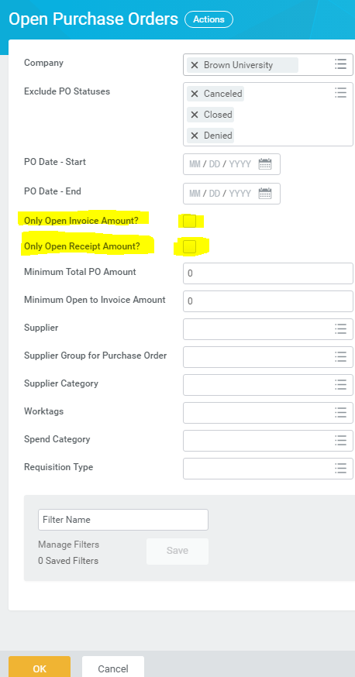
Closing Purchase Orders (continued)
To Find all open purchase orders, use the “Open Purchase orders” Workday report (includes Requisition Type).
Keep both dates blank –
(PO Date - Start & PO Date)
Uncheck these highlighted boxes (De-select “Only Open Invoice Amount” and “Only Open Receipt Amount”)
Enter applicable Worktags, such as Cost Center, Grant, etc.
Tip: To easily see zero (0.oo) and low dollar balance POs in the report, click in column header “Open to Invoice (New)” and select ascending order to sort by remaining balance.

Slide 15
Tips to Avoid Delays
Top reasons that Procurement will send back a Requisition:
Documentation is missing
Spend category is incorrect
Signature on contract is not authorized, or there is no signature
Requisition includes supplier terms and conditions that have not been reviewed
Contract Review needed for a supplier’s quote:
If there are terms and conditions included in a supplier’s quote, including hyperlinks to terms and conditions, be sure to have them reviewed by submitting a contract review request in BCM before creating a purchase requisition
Use Strategic suppliers when possible:
Add the Brown Strategic Supplier report to your Apps Menu
Type Strategic Supplier in Workday search
Go to SPC Home Page
All Procurement related questions should be submitted through our Deskpro ticketing system.
Notes:
To find Strategic Suppliers, go to SPC Home and click on Strategic Sourcing link; or in Workday, type Strategic Supplier into the search box.
Strategic Suppliers are suppliers having established relationships with Brown and negotiated university-wide discount pricing agreements. They are called “Strategic Supplier” to be clear that the designation of these suppliers is not based on user preference

Slide 16
Accounts Payable and Payroll
Supplier Invoices, Miscellaneous Payment Requests, Expense Reports & PCard– Closing Dates
Manual Accruals & Prepaid expenses
FY26 Salary Expense & Payroll Accounting Adjustments
Sarah Peri, Director of Operations and Outreach
Nichole Curley, Associate Controller

Slide 17
Supplier Invoices & Miscellaneous Payments – Closing Date
Accounts Payable transactions in Workday will close at 4:00 pm on July 15th for FY26
All supplier invoices and miscellaneous payments dated June 30th or prior and for goods or services received or performed in FY26 that have fully completed the business process will be automatically accrued in Workday (i.e. the expense will be recorded to FY26).

Slide 18
Miscellaneous Payment Requests
A miscellaneous payee is an individual requiring payment from Brown University who does not meet the requirements to become a supplier.
See Supplier Management / Miscellaneous Payments information and FAQ’s
Visitor Travel (394o)– Non-University personnel travel expenses… Do not use air, hotel, meals etc. spend categories.
Notes:
Remember to allow time for foreign nationals (for miscellaneous payments).

Slide 19

Expense Reports – Closing Date
Expense reports (with the exception of the travel card) will close in Workday at 4:00 pm on July 15th for FY26.
If the expense report is for travel or other reimbursable items incurred in FY26, you will need to change the expense report date to June 30, 2026 (to record in FY26)

Slide 20
Expense Reports when paid by a Travel Card
Expense reports that have June 30 or earlier charges on a Travel Card need to be completed through the business process by July 9th.
The travel card charges date defaults in, so ensure the expense report date is within the same fiscal year.
Accounts Payable with reach out to anyone who does not meet this deadline and there is a risk the travel card holder’s card will be suspended.

Slide 21
Expense Report Reminders
Dinners / Lunches – list attendees and break out alcohol…use spend category exclusions (3950)
Business Purpose – Who, What, Where, & Why…Be descriptive.
Be mindful that there are separate spend categories for domestic vs. international travel expenses.
An online or virtual course does not represent an international expense.

Slide 22
Pcard Verification and Approvals
Pcard verifications must be completed by July 9th at 4:00 pm. When verifying a FY26 Pcard transaction in July, change the document date to 6/30/26 or prior to record to FY26.
Pcard verifications with a document date in FY26 need to be fully approved through the Workday business process by July 15th at 4:00 pm.
Any FY26 Pcard transactions that have not been fully approved through the business process by 4:00 pm on July 15th will be advanced forward by Central AP and recorded to FY26 on July 15th.
Accounting can be reviewed and journal entries submitted to correct worktags/spend categories as needed through July 20th at 4:00 pm.

Slide 23
Pcard Reminders
A business purpose is required in the memo field on the Pcard verification
If it is blank you will get a “Red hard stop” warning
Don’t forget to attach receipts!

Slide 24
Helpful Pcard & Travel Card Reports
Find Credit Card Transactions for Departments
for Pcard
access: Financial Coordinator
Find Travel Card Transactions for Departments
for Travel Card
access: Financial Coordinator

Slide 25
Manual accruals
There are generally NO manual accruals*
*Accruals may be allowed in certain circumstances if material and must be booked directly by the Controller’s Office by July 20th.
Please contact us at accounting@brown.edu
Notes:
Because we allow the system to record activity automatically in the correct fiscal period by leaving areas open, so there is sufficient time to record most activity in the correct fiscal year.

Slide 26
Prepaid Expenses
Expenses $10,000 or greater for FY27 requiring payment prior to July 1st can be processed by Accounts Payable if clearly marked “PREPAID FY27” in the memo field.
For example: PREPAID FY27 subscriptions (the invoice from the supplier should clearly note it is for a service after June 30)
The Controller’s Office will review and record a manual journal entry by July 16th to record the FY27 expense.

Slide 27
Salaries, Wage & Fringe Benefit Expenses
Workday will record salary expense to FY26 through the following payroll period end dates:
*Weekly payroll period ending July 4th and biweekly payroll period ending July 11th will be recorded in FY27
Salary frequency | Pay period end date
Monthly | June 30, 2026
Biweekly | June 27, 2026
Weekly | June 27, 2026

Slide 28
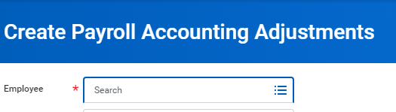
Payroll Accounting Adjustments
FY26 payroll accounting adjustments (PAAs) that are approved and completed through the entire Workday business process by the end of the day on July 15th will be posted in FY26.
After July 15th any PAA’s that do not involve sponsored grants (FD500) will be denied.
Notes:
Remember no JE’s for payroll transactions (should be done via PAA)!
Training on submitting PAA’s is available in Workday Learning, and keep an eye out on the Workday login page for in-person trainings (also over payroll Costing, Workday Reporting Basics, Workday Financials Basics, etc.)

Slide 29

Payroll Accounting Adjustments (cont.)
Continually review the In Progress Payroll Actuals and Payroll Actuals reports in Workday.
Once a worker terminates (including students!!), a PAA can no longer be submitted to adjust the worktags charged for their pay, so please submit PAAs on a timely basis! Please contact accounting@brown.edu for assistance, especially if a grant is involved.
Notes:
Remember no JE’s for payroll transactions (should be done via PAA)!
Training on submitting PAA’s is available in Workday Learning, and keep an eye out on the Workday login page for in-person trainings (also over payroll Costing, Workday Reporting Basics, Workday Financials Basics, etc.)

Slide 30
Financial Services
Financial Operations & Cashier Office Updates
Deposits
Credit Card Receipts
Customer Accounts
Bookstore Internal Service Deliveries
Matthew Cerullo, Director of Financial Services Operations
Wynette Zuppardi, Assistant Vice President, Financial Services

Slide 31
Financial Services Operations & Cashier Updates & Reminders
Change in Acceptance of Foreign Checks
US Treasury discontinuation of the Penny & best practices

Slide 32
Deposits
Hours of Operation
Wednesday | 6/24/26 | 9:00 AM to 3:00 PM
Thursday | 6/25/26 | Closed
Friday | 6/26/26 | 9:00 AM to 3:00 PM
Monday | 6/29/26 | 9:00 AM to 3:00 PM
Tuesday | 6/30/26 | 9:00 AM to 3:00 PM
Submit deposits by 12:00 noon on Tuesday, June 30th to ensure processing for FY26
The Cashier Office will process deposits through closing on June 30th at 4:00; guarantee the FY26 deposits by getting your deposit in by June 30th at noon!
Closing – done ONCE on Tuesday June 30th
No accruals/backdating on any deposits!

Slide 33
Credit Card Receipts
Credit Card receipts will be processed by the bank receipt date.
Keep in mind the timing of receipt of funds – approximately 1-4 days after transaction.
Notes:
i.e. Revenue is posted based on when the money is received by the bank (not when they process the transaction)

Slide 34
Customer Accounts Receivable
All University departments that provide goods and/or services to customers and invoice for goods/services, are required to utilize the central system Workday. This process, Customer Accounts Receivable, ensures that all receivables are appropriately recorded to the University general ledger.
If you need training, or a training refresher, contact Financial Services at customeraccounts@brown.edu

Slide 35
Customer Accounts
All customer invoices for FY26 must be created/submitted by June 30, 2026
For FY27 -- beginning June 15, 2026, you may submit customer invoices with a date of July 1, 2026; this will reflect the revenue in FY27
July 1, 2026, DO NOT backdate any customer invoices (normal policy)
Accounts with balances over 180 days past will be reviewed with departments individually for potential write off in FY26
Brown University Health (BUH) now requires POs for payment; effective 7/1/26 any BUH customer invoice submitted without a PO will be sent back to the AR Coordinator.

Slide 36
Bookstore Internal Service Deliveries (ISDs)
ISDs replace IPRs to create a streamlined process for departmental charges at the bookstore
All ISDs dated on/before June 30, 2026 must be approved by cost center managers by 4:00 July 9, 2026

Slide 37
General Accounting
Journal Entries
Deficit Balances
Workday Allocations
Nichole Curley, Associate Controller

Slide 38
Journals - integrations
All integrations / internal service journal entries will be recorded by July 15th
These include the following internal charges:
Planon Pinnacle (CIS Wireless/Telephone)
Bookstore Dining
Graphics Airgas, etc.

Slide 39
Internal Service Deliveries- ISDs
Cost Center Managers and Grant Managers will need to review and approve purchases in Workday from the Brown Bookstore that are charged to the cost centers or grants they support. These items will be identified as Internal Service Delivery (ISD) events
Refer to the Workday Job Aid “Reviewing and Approving Internal Bookstore Purchases”
Reference Internal Service Delivery (ISD) FAQs
Use the report “Find Internal Service Delivery Lines for Organization” to locate ISDs in progress
All questions related to ISDs can be directed to accounting@brown.edu

Slide 40
Journal Entries – Year-end timing
FY26 journals will be accepted by the Controller’s Office until 4:00 pm on July 20th
Be careful with dates on journal entries and include the appropriate fiscal year in the header and memo fields to expedite posting entries!
Salesforce reminder (need to manually populate the date, please backdate if appropriate).
To expedite posting JE’s submitted in July, please clearly indicate the fiscal year in the memo:
FY26 Entries:
Backdate to 6/30/26
Add “FY26 entry” in Salesforce header and memo field
FY27 Entries:
Date 7/1/26 or later
Add “FY27 entry” in Salesforce header and memo field
The Controller’s Office will complete its review and approval by July 21st (all operating fund activity should be complete).
Notes:
Operating funds include: FD100, FD110, FD120, FD400, FD500, FD600 (SALESFORCE REMINDER – Change in UI interface and date stops auto-populating between 7/1-8/1

Slide 41
Deficit Balances
Endowments, spendable gifts and agency funds in deficit must be covered by another funding source.
Please contact Maureen Moran, Director of Gifts and Endowments at maureen_moran@brown.edu for assistance with identifying alternative funding sources or for questions regarding gift or endowment terms.
Helpful Workday reports:
Endowment Income Report
Spendable Gift Report
Agency Account Report

Slide 42
Other Helpful Reports
Manager Activity Report – Actuals
Manager Activity (Excl. Sponsored Activities)
Select Balance Sheet for Managers
Sponsored Award Budget to Actuals
Sponsored Award(s) Activity – Actuals
Payroll Actuals by Cost Center (With Worktags)
In Progress Payroll Actuals by Cost Center (All Organizations)
Find Internal Service Delivery Lines for Organization

Slide 43
Designated Funds Transfers (DFTs)
DFTs are only applicable to specific departments that need to close out funds (you know who you are)
When submitting DFTs in Salesforce, remember to use the drop down menu to select the journal source “Designated Funds Transfer” and use spend category 9310
DFTs route first to Budget office for approval and then to general accounting
FY26 designated fund transfers reserve journal entries (FD130 – reserves) will be accepted by the Budget / Controller’s Office until 4:00 pm on July 23rd
Units will be contacted by the Budget / Controller’s office if any additional adjustments need to be made

Slide 44
Workday Allocations
Facilities and sold service related allocations will be run by the Controller’s Office by July 21st
Reserves – Allocations to close out cost centers to reserves (FD130) will also be run by the Controller’s office by July 21st
Note: Workday will be unavailable Saturday July 18th from 2 am to 1 pm for scheduled maintenance.

Slide 45
Table: Summary of Key Dates
 | Table: Summary of Key Dates
Through June 30, 2026 | 1. Memo noting FY27 payments now through June 30, should state: “PREPAID FY27” 2. Departments must close completed Purchase Orders 3. Create receipt ASAP on goods received by June 30th
June 30 | Deposits must be made by 12:00 pm
July 9 | Pcard transactions must be verified in Workday by 4:00 pm Travel card transactions need to have an expense report created & submitted by 4:00 pm Departments will be notified of all inflight transactions (PAAs, ISDs)
July 15 | Pcard transactions must be fully approved through the business process by 4:00 pm
July 15 | Last day FY26 operational activity including internal services, ISDs, supplier invoices, miscellaneous payments & expense reimbursements can be recorded in Workday. Any Pcard, Tcard and ISD transactions that have not been approved will be approved centrally. * Must complete entire business process
July 20 | Manual FY26 journals accepted until 4:00 pm (please remember to backdate to 6/30/26 and include FY26 in description!)
July 21 | All facility allocations / sold services are run
July 21 | All operating fund activity is complete, and reserves allocations are run
July 23 | FY26 designated fund transfers reserve journal entries (FD130 – reserves) will be accepted by Budget / Controller’s Office until 4:00 pm (* Designated Fund Transfer journal source should be used)

Slide 46

Thank you, and happy year-end!

